Slide 1
ELECTRIC VEHICLES DATA ANALYSIS

Slide 2
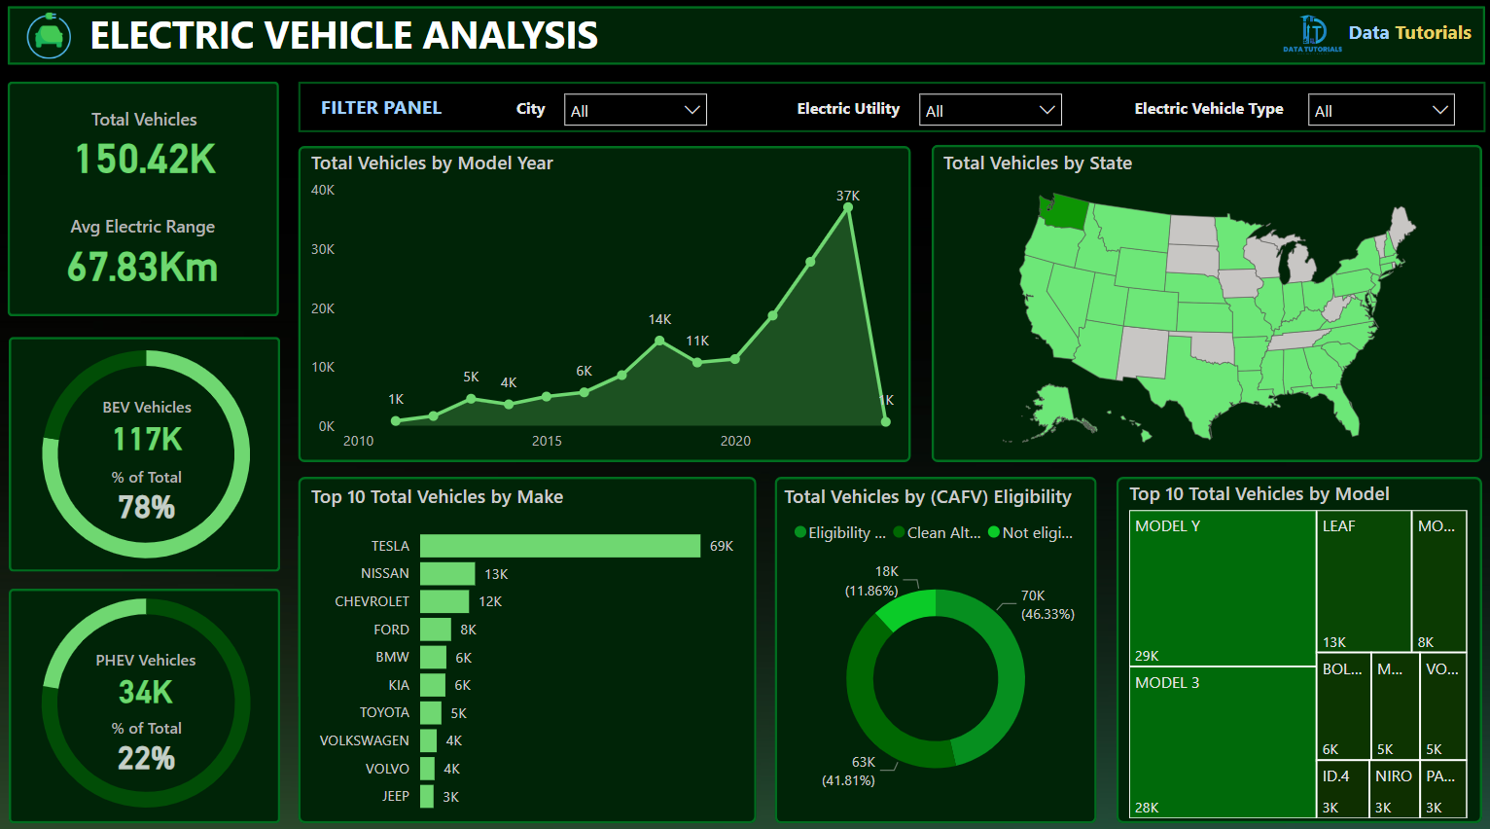
PROBLEM STATEMENT
KPI’S Requirement
Total Vehicles:
Understand the overall landscape of electric vehicles, encompassing both BEVs and PHEVs, to assess the market's size and growth.
2. Average Electric Range:
Determine the average electric range of the electric vehicles in the dataset to gauge the technological advancements and efficiency of the EVs.
3. Total BEV Vehicles and % of Total BEV Vehicles:
Identify and analyze the total number of Battery Electric Vehicles (BEVs) in the dataset.
Calculate the percentage of BEVs relative to the total number of electric vehicles, providing insights into the dominance of fully electric models.
4. Total PHEV Vehicles and % of Total PHEV Vehicles:
Identify and analyze the total number of Plug-in Hybrid Electric Vehicles (PHEVs) in the dataset.
Calculate the percentage of PHEVs relative to the total number of electric vehicles, offering insights into the market share of plug-in hybrid models.

Slide 3
PROBLEM STATEMENT
Charts Requirement
Total Vehicles by Model Year (From 2010 Onwards):
Visualization: Line/ Area Chart
Description: This chart will illustrate the distribution of electric vehicles over the years, starting from 2010, providing insights into the growth pattern and adoption trends.
2. Total Vehicles by State:
Visualization: Map Chart
Description: This chart will showcase the geographical distribution of electric vehicles across different states, allowing for the identification of regions with higher adoption rates.
3. Top 10 Total Vehicles by Make:
Visualization: Bar Chart
Description: Highlight the top 10 electric vehicle manufacturers based on the total number of vehicles, providing insights into the market dominance of specific brands.
4. Total Vehicles by CAFV Eligibility:
Visualization: Pie Chart or Donut Chart
Description: Illustrate the proportion of electric vehicles that are eligible for Clean Alternative Fuel Vehicle (CAFV) incentives, aiding in understanding the impact of incentives on vehicle adoption.
5. Top 10 Total Vehicles by Model:
Visualization: Tree map
Description: Highlight the top 10 electric vehicle models based on the total number of vehicles, offering insights into consumer preferences and popular models in the market.

Slide 4
Total Vehicles by Model Year (2010 Onwards)
Insight
EV registrations increased steadily from 2010 and grew rapidly after 2020.
The highest registrations are observed in the latest available years.
Reason
Government incentives encouraged EV purchases.
Battery technology improved, providing longer driving ranges.
Charging infrastructure expanded.
More manufacturers launched affordable EV models.
Rising fuel prices made EVs a more economical long-term option.
Business Conclusion
The EV market is experiencing strong growth and is expected to continue expanding.

Slide 5
Total Vehicles by State
Insight
Washington State has the highest concentration of electric vehicles.
A few states account for the majority of EV registrations.
Reason
Better charging infrastructure.
State tax incentives and rebates.
Higher environmental awareness.
Higher urban population and purchasing power.
Business Conclusion
EV adoption is strongest in regions with supportive government policies and developed infrastructure.

Slide 6
Top 10 Vehicles by Make
Insight
Tesla dominates the market with the highest number of registered EVs.
Nissan, Chevrolet, Ford, and BMW follow.
Reason
Tesla entered the EV market early.
Longer battery range.
Strong brand reputation.
Extensive Supercharger network.
Continuous software updates and innovation.
Business Conclusion
Brand reputation, technology, and charging infrastructure play a major role in customer purchasing decisions.

Slide 7
Total Vehicles by CAFV Eligibility
Insight
A large percentage of vehicles are eligible for Clean Alternative Fuel Vehicle (CAFV) incentives.
Reason
Manufacturers designed vehicles to meet government eligibility standards.
Buyers prefer vehicles that qualify for tax credits and rebates.
Incentives reduce the effective purchase cost.
Business Conclusion
Government incentive programs significantly influence EV adoption.

Slide 8
Top 10 Vehicles by Model
Insight
Tesla Model Y and Tesla Model 3 are the most popular EV models.
Reason
High driving range.
Advanced safety features.
Competitive pricing compared to luxury EVs.
Excellent charging network.
Strong resale value.
Business Conclusion
Consumers prefer EV models that offer the best balance of range, technology, and price.

Slide 9
Recommendation from insights
The Nissan LEAF and Chevrolet Bolt EV have the highest registrations among their respective brands, indicating they are one of the most popular models in this dataset after TESLA.
They need to work on their Technology to improve efficiency.

